Slide 1
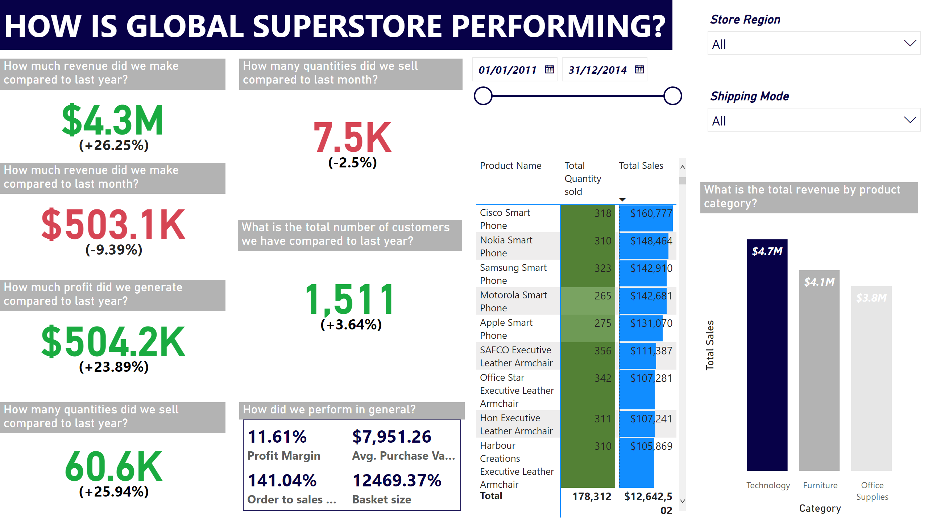
Executive Report
Notes:
textbox
No alt text provided
How much revenue did we make compared to last year?
No alt text provided
How much profit did we generate compared to last year?
No alt text provided
How much revenue did we make compared to last month?
No alt text provided
How many quantities did we sell compared to last year?
No alt text provided
How many quantities did we sell compared to last month?
No alt text provided
What is the total number of customers we have compared to last year?
No alt text provided
How did we perform in general?
No alt text provided
pivotTable
No alt text provided
slicer
No alt text provided
slicer
No alt text provided
slicer
No alt text provided
What is the total revenue by product category?
No alt text provided

Slide 2
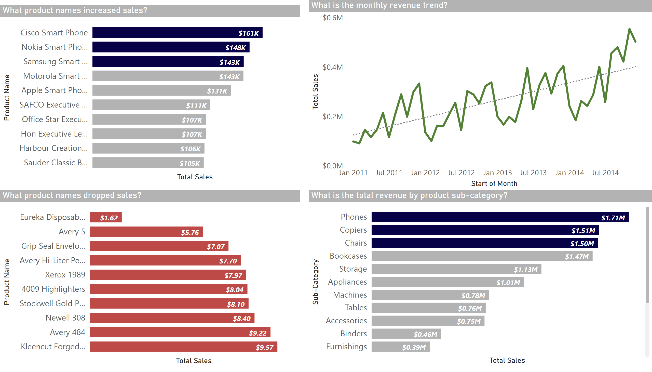
Product Report
Notes:
What is the total revenue by product sub-category?
No alt text provided
What is the monthly revenue trend?
No alt text provided
What product names increased sales?
No alt text provided
What product names dropped sales?
No alt text provided

Slide 3
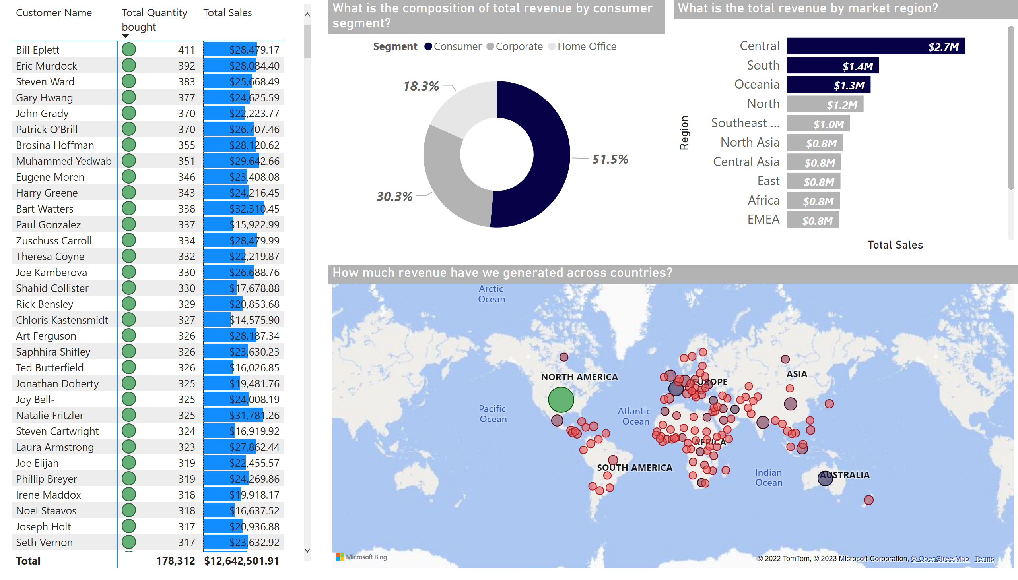
Customers Report
Notes:
pivotTable
No alt text provided
What is the composition of total revenue by consumer segment?
No alt text provided
What is the total revenue by market region?
No alt text provided
How much revenue have we generated across countries?
No alt text provided

Slide 4
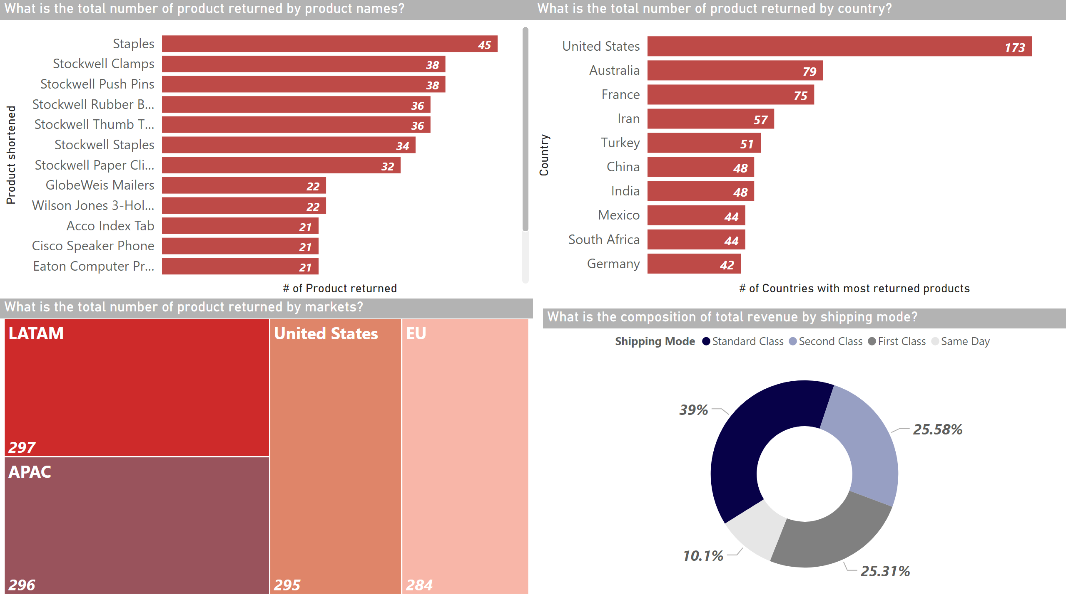
Returns Report
Notes:
What is the total number of product returned by product names?
No alt text provided
What is the total number of product returned by country?
No alt text provided
What is the total number of product returned by markets?
No alt text provided
What is the composition of total revenue by shipping mode?
No alt text provided

